Slide 1
Let's play
School is fun!

Slide 2
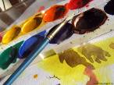
Pronounce the words correctly:
[a:] [ju:] [∫] [t∫]
art you sharpener picture
ask computer bookshelf teacher
answer pupil dictionary question
heart music Russian Literature

Slide 3
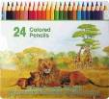
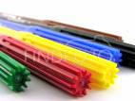
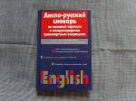
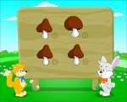
Find the words:
[’kla:srum] -
[’blækbo:d] -
[’buk∫elf] -
[’pikt∫ə] -
[’∫a:pnə] -
[’dik∫ənəri] -
sharpener
dictionary
classroom
picture
bookshelf
blackboard

Slide 4
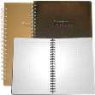
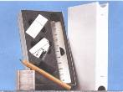
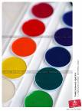
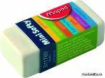
[kəm’pju:tə] -
[’ru:lə] -
[peints] -
[’eksəsaizֽbuk] -
[’ti:t∫ə] -
[’pju:pl] -
[æk’tivitiֽbuk] -
[kə’setri’ko:də] -
ruler
computer
pupil
cassette recorder
paints
teacher
activity book
exercise book

Slide 5
school

Slide 6
What do you take with you to school?

Slide 12
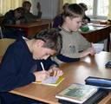
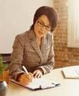
to write

Slide 13
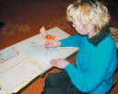
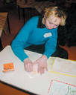
to draw

Slide 14
to study

Slide 15
to read

Slide 16
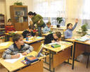
Вправа№1. Замінити малюнок відповідним словом.
I at school.
My is big.

Slide 17
Вправа№2. Вставити слово, близьке за змістом .
To study, to read, …
A teacher,…
A desk,…
A school,…

