Slide 1
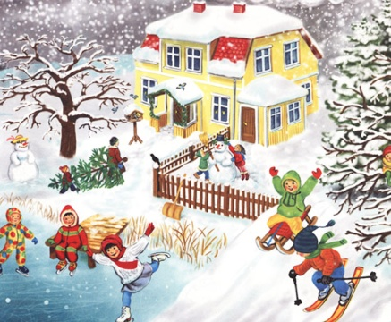
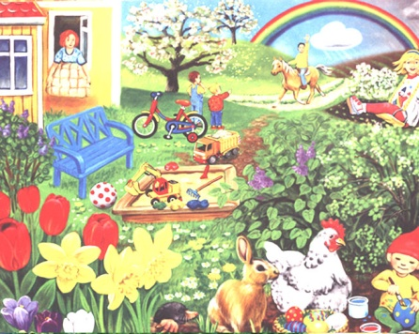
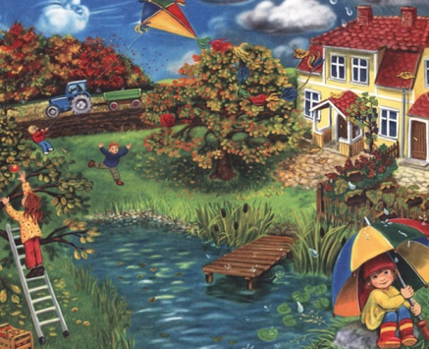
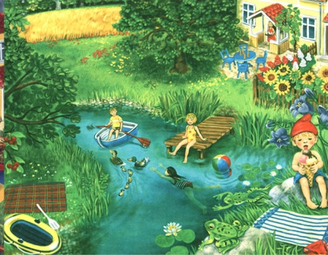
SEASONS

Slide 2
Seasons. Months
WINTER
December
January
February
SPRING
March
April
May
AUTUMN
September
October
November
SUMMER
June
July
August

Slide 3
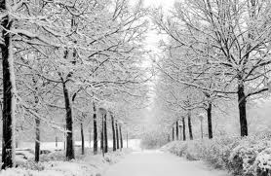
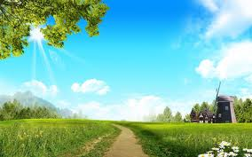
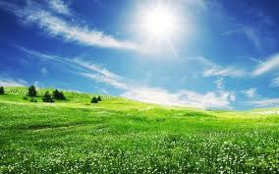
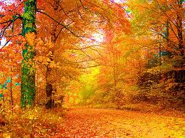
Seasons

Slide 4
SPRING

Slide 5
SUMMER

Slide 6
AUTUMN

Slide 7
WINTER

Slide 8
Look and say what season comes after…
… comes after autumn.
… comes after winter.
… comes after spring.

Slide 9
Summer comes after…
Spring comes after…
Autumn comes after…

Slide 10
… comes after…
…comes after … …comes after…

Slide 11
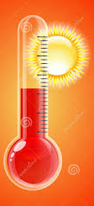
Weather
hot
warm
It is ...
It is ...

Slide 12
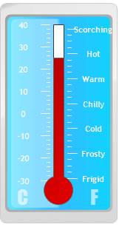
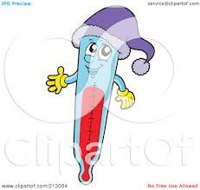
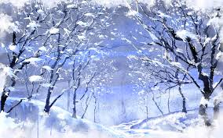
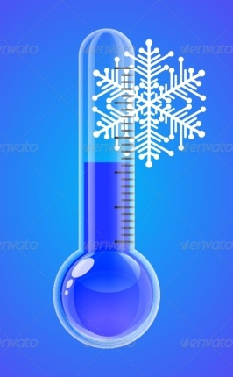
Weather
cold
It is
...

Slide 13
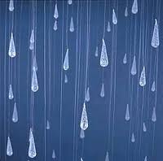
Weather
It is…

Slide 14
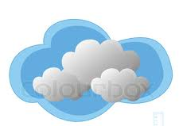
Weather
It is…

Slide 15
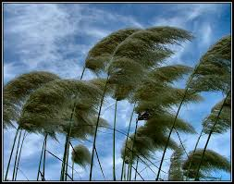
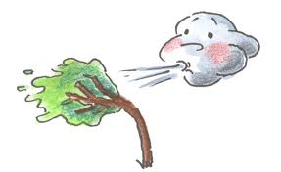
Weather
It is…

Slide 17
Present Perfect Теперішній доконаний час
I
We
You
They
He
She
It
have
V
3
V
V
ed
3
has
V
3

Slide 18
Present Perfect Теперішній доконаний час
I
We
You
They
He
She
It
not V
have
3
V
V
ed
3
not V
has
3

Slide 19
Present Perfect Теперішній доконаний час
I
we
you ?
they
He
She ?
It
Have
V
3
V
V
ed
3
Has
V
3

