Slide 1
Kharkiv

Slide 2
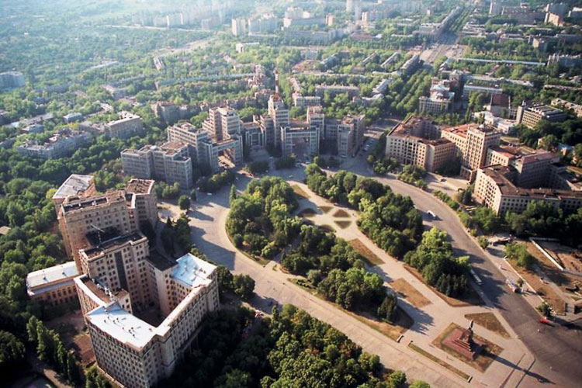
Freedom Square

Slide 3
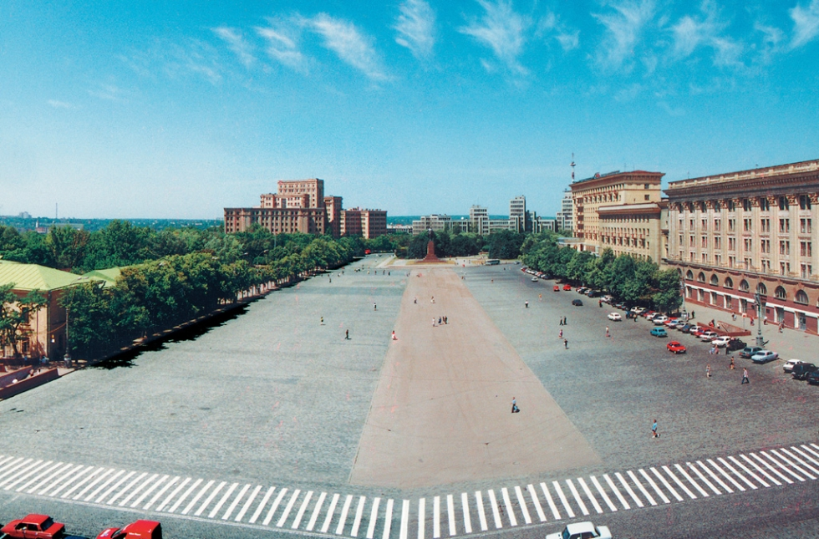

Slide 4
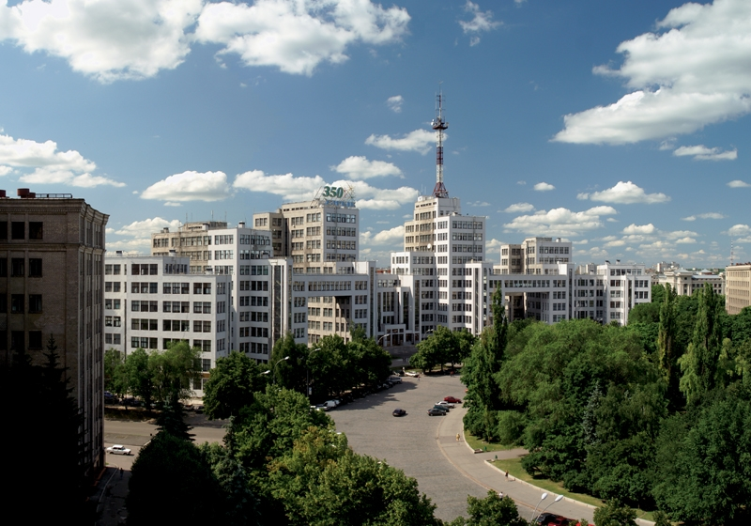
Derzhprom building

Slide 5
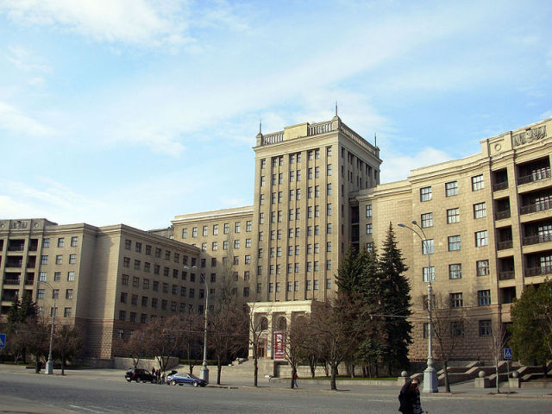
Kharkiv National University named after Karazin

Slide 6
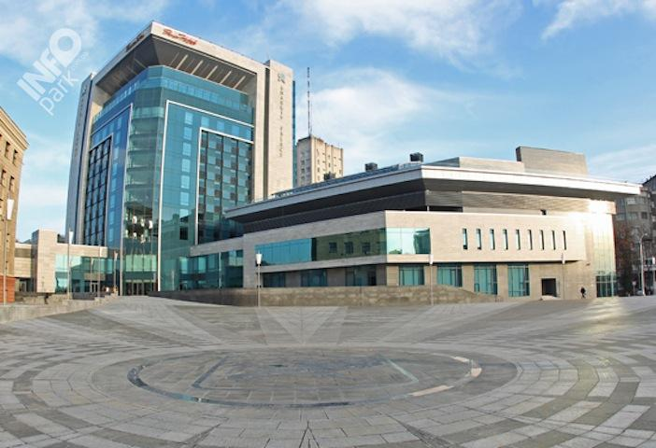
Kharkiv Palace hotel

